Slide 1
LDO Project Design Testbenches & Results
Muhammad Aldacher

Slide 2
LDO Design with chosen values
V = 1.2 V
DD
V
GS
V
V
DS
G
V = 0.9 V
REG
I = 5 ~ 30 mA
I
L
V = 0.75 V
R
R = 1K
V
REF
1
FB
R = 5K
C = 200 pF
2
L
50 uA

Slide 3
1) DC Analysis

Slide 4
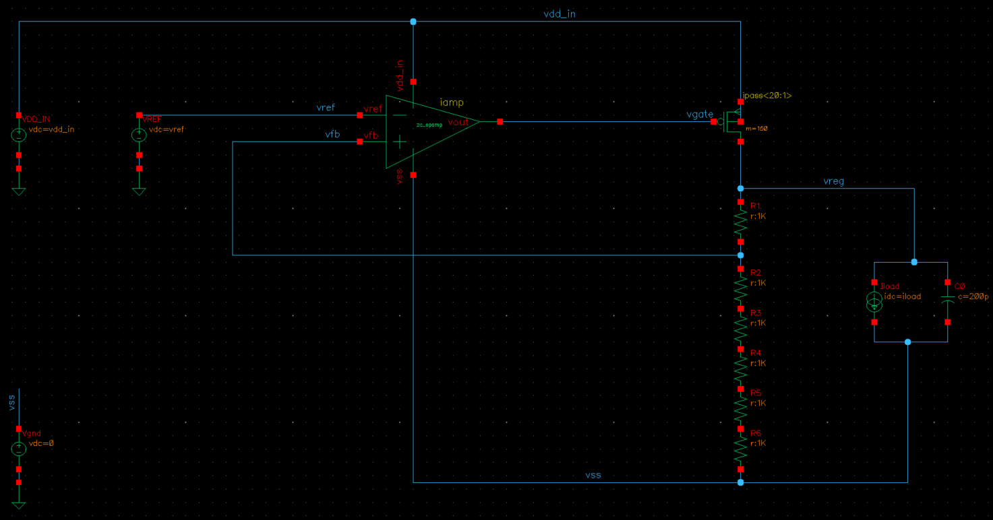
Testbench Schematics (LDO)
LDO
load

Slide 5
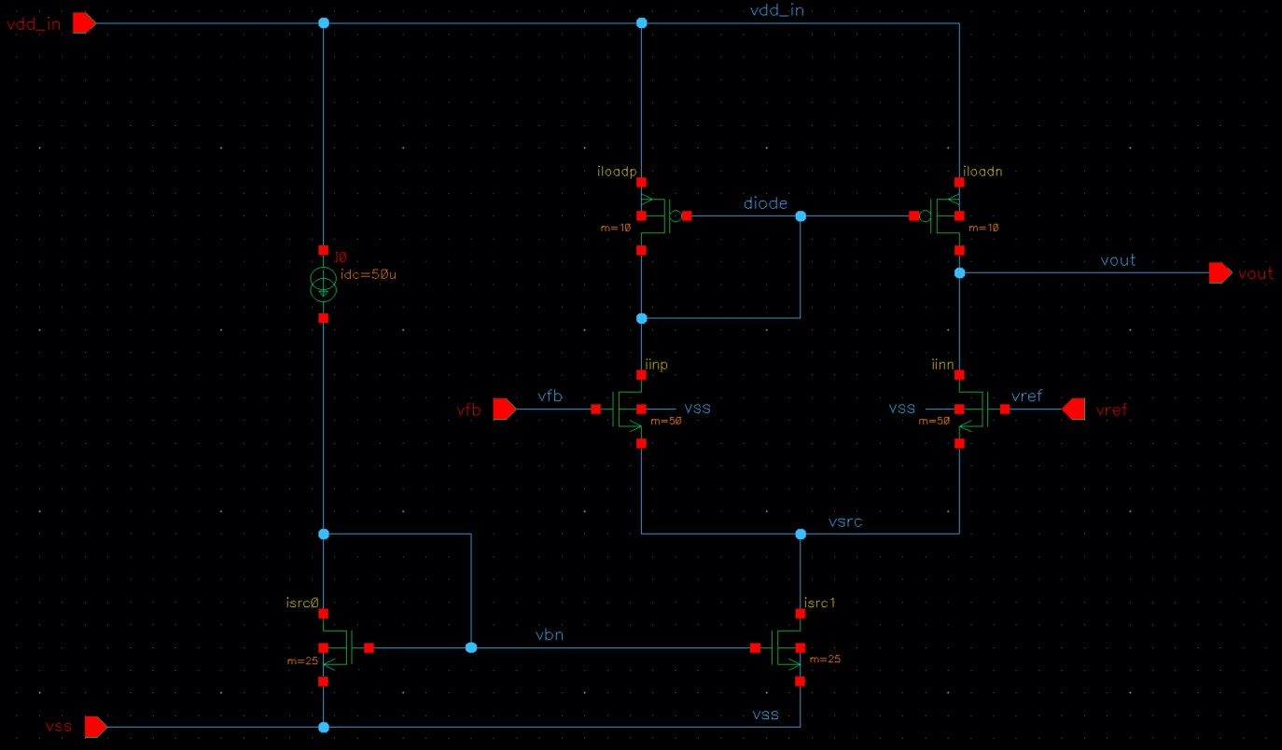
Testbench Schematics (OpAmp)

Slide 6
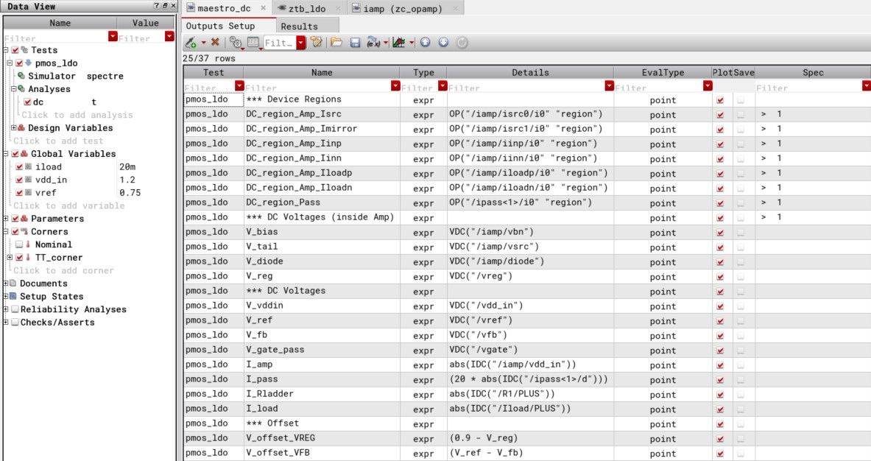
Testbench Maestro View

Slide 7
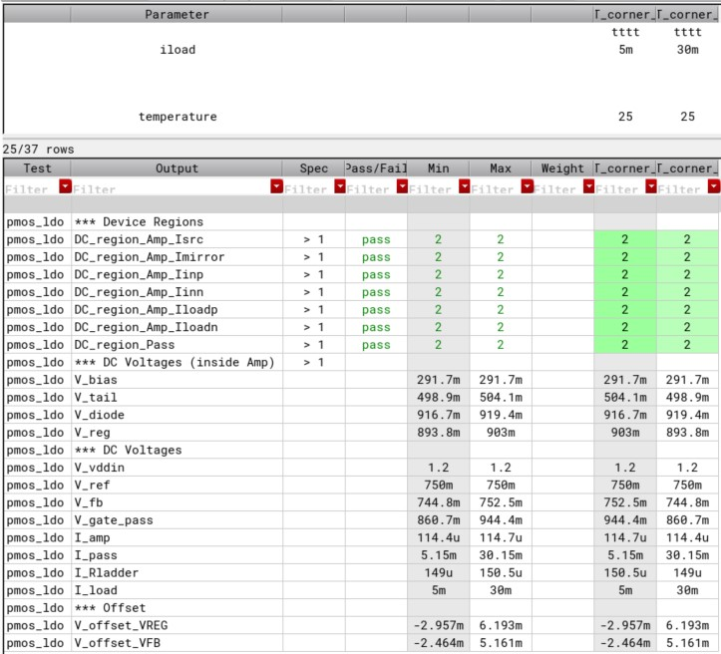
Results
All the devices are in SAT for Max & Min loads

Slide 8
2) Monte-Carlo Analysis

Slide 9
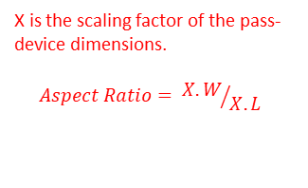
Testbench Schematics (LDO)
X is the scaling factor of the pass-device dimensions.
$$Aspect Ratio= {X.W}/{X.L}$$
LDO
load
This current source is replaced with R = vreg/iload .
(The IDC current source may give incorrect monte-carlo results)

Slide 10
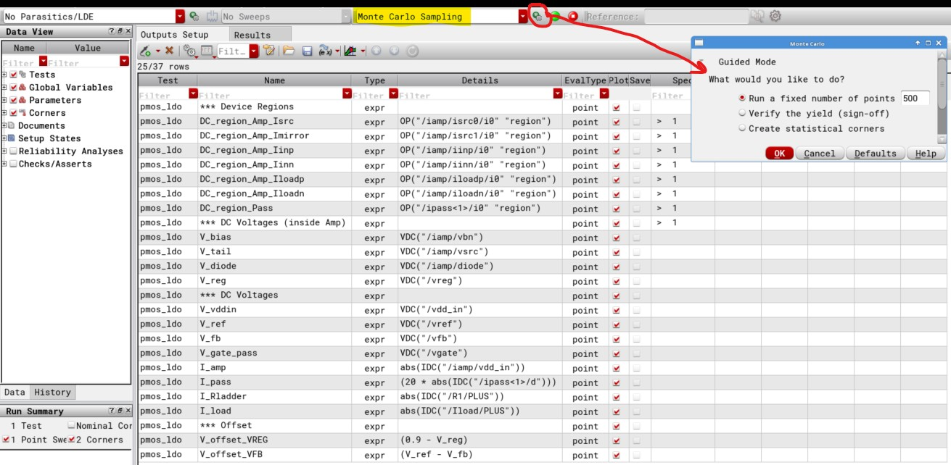
Testbench Maestro View

Slide 11
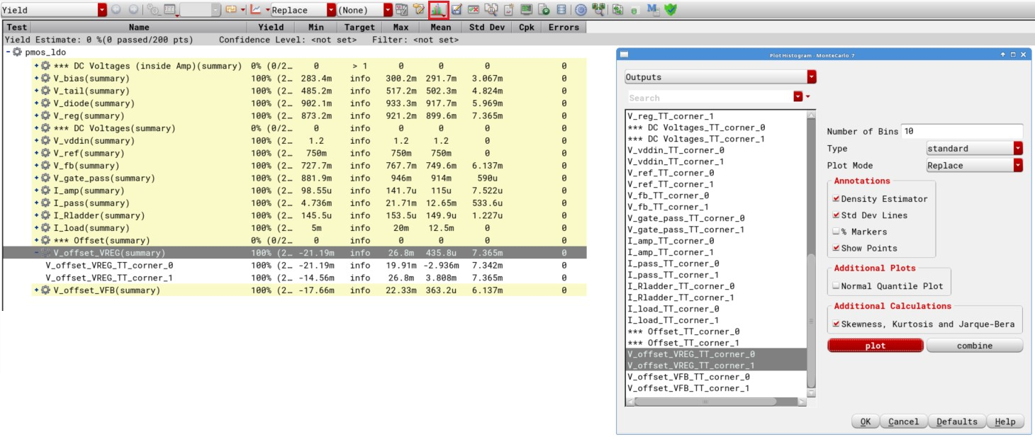
Plotting Histogram (After Simulation)

Slide 12
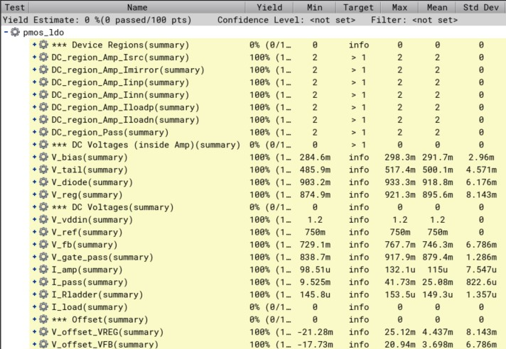
Results (with x=1)
Mean
Sigma

Slide 13
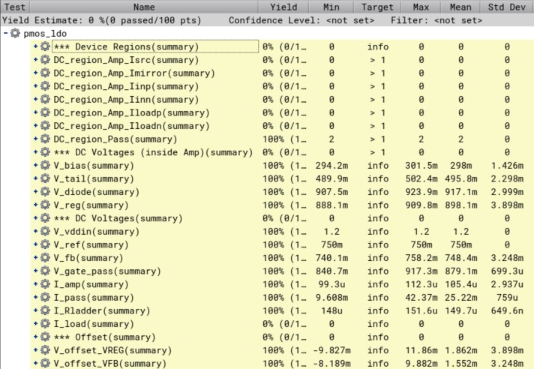
Results (with x=2)
Mean
Sigma

Slide 14
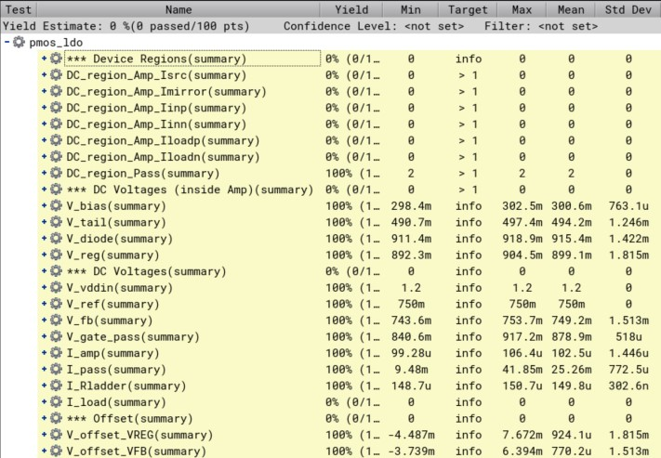
Results (with x=4)
Mean
Sigma

Slide 15
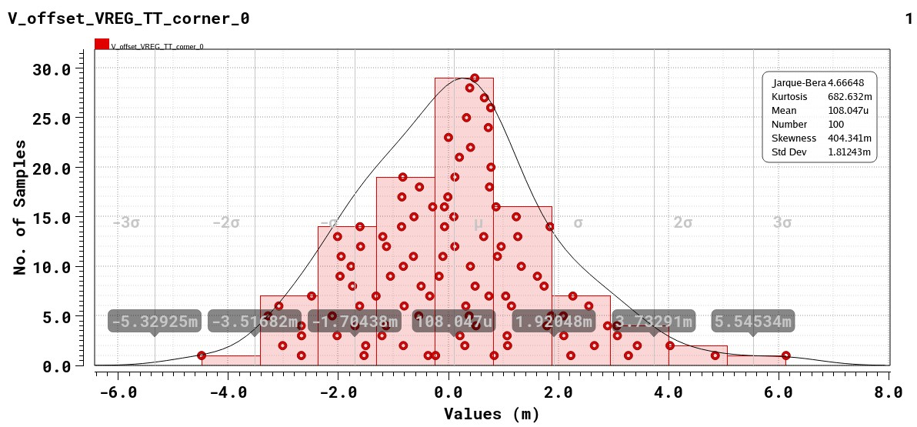
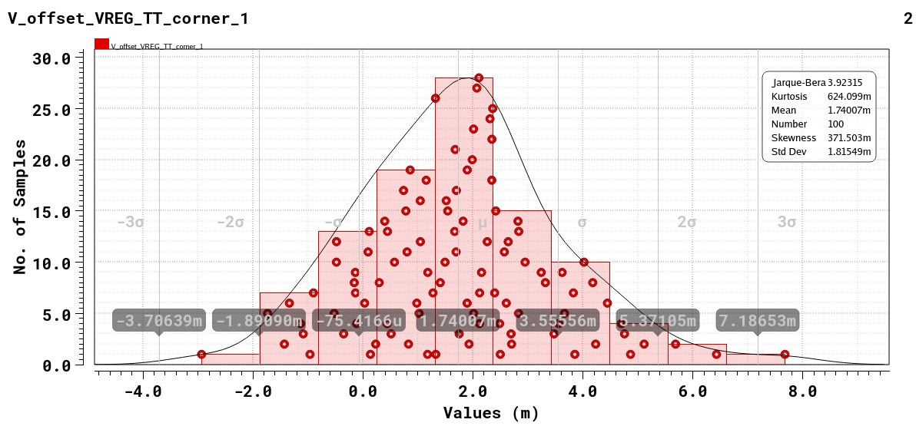

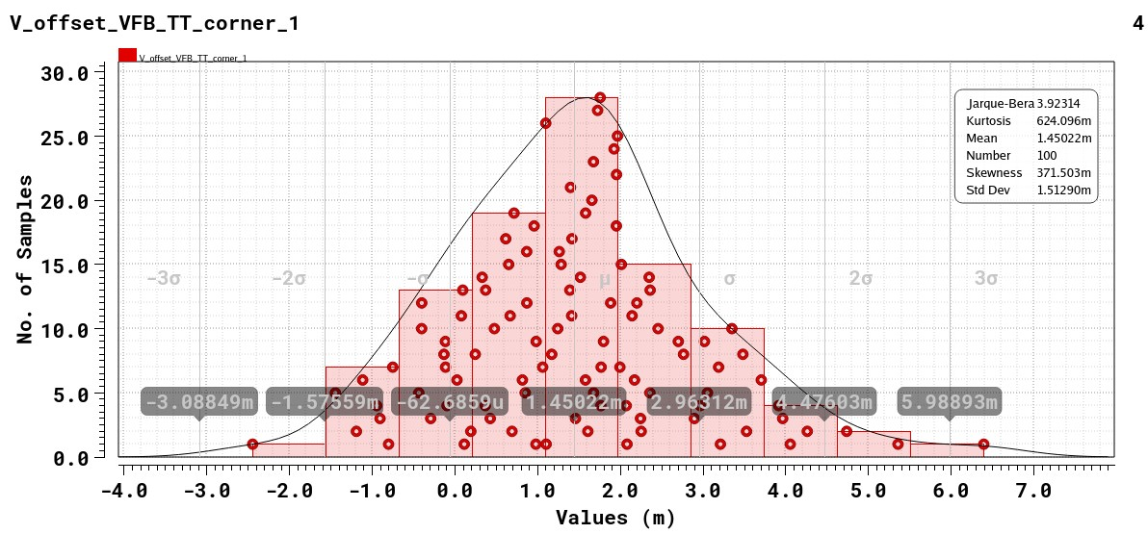
Results (with x=4)
Iload = 5mA
Iload = 30mA
VREG
VFB

Slide 16
3) AC Analysis

Slide 17
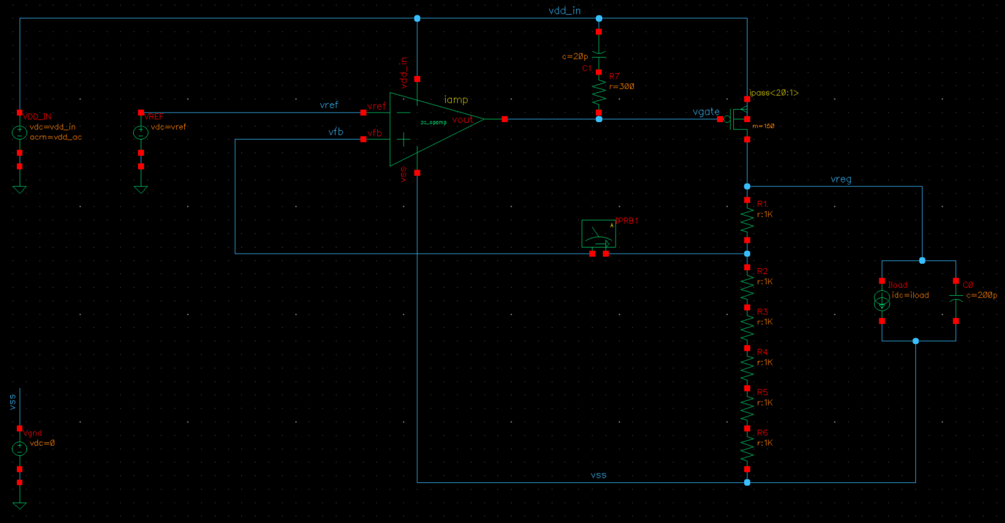
3) A. RC Compensation: Testbench Schematics
RC compensation
load

Slide 18
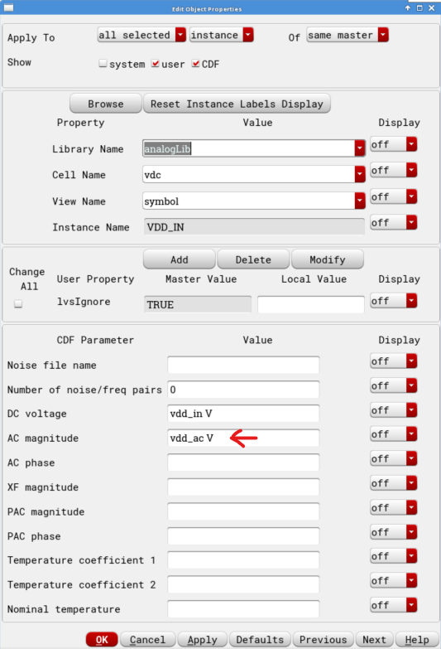
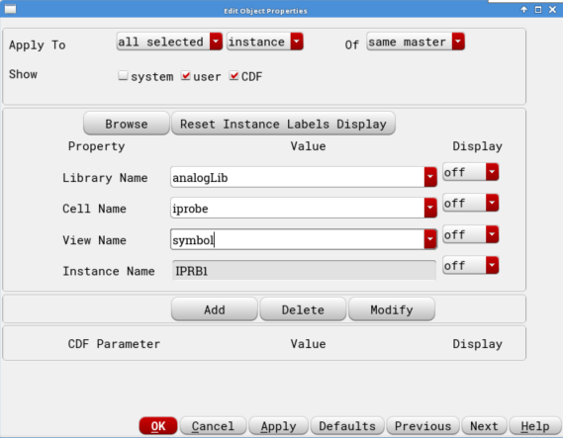
3) A. RC Compensation: Testbench Schematics
RC compensation
load

Slide 19
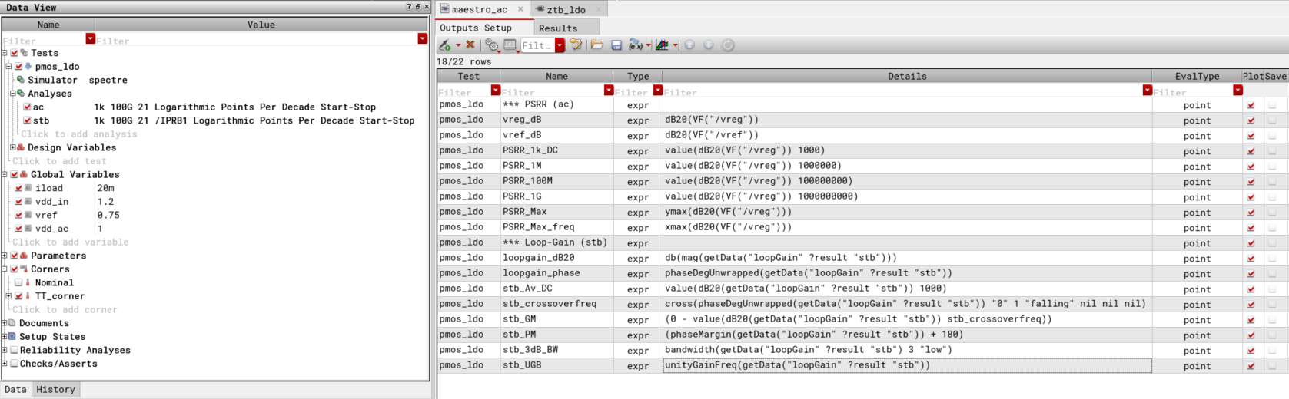
3) A. RC Compensation: Testbench Maestro View

Slide 20
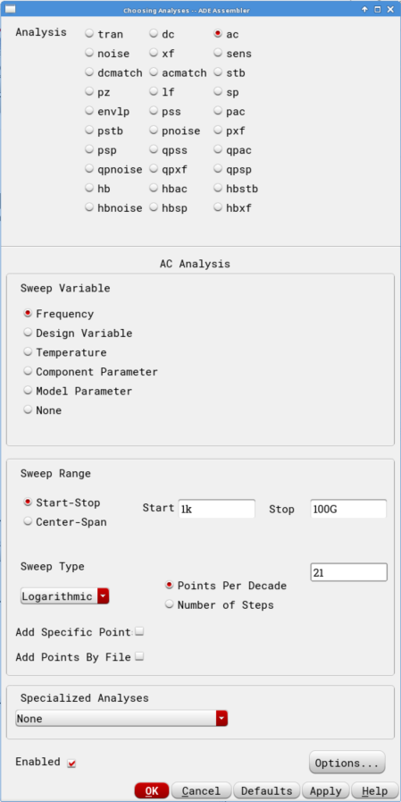
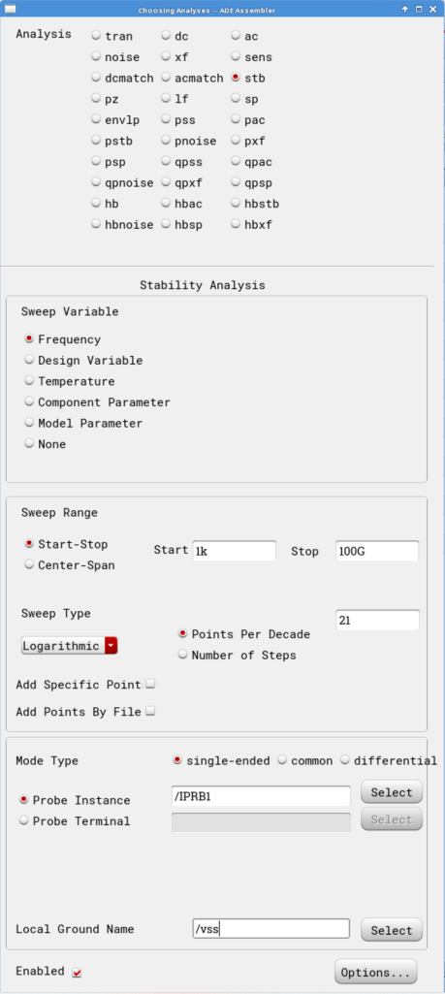
3) A. RC Compensation: Testbench Maestro View
AC Analysis
STB Analysis

Slide 21
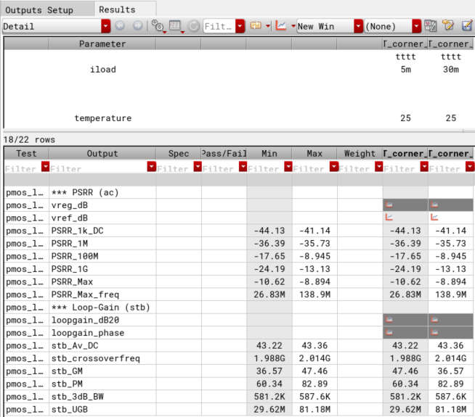
3) A. RC Compensation: Results

Slide 22
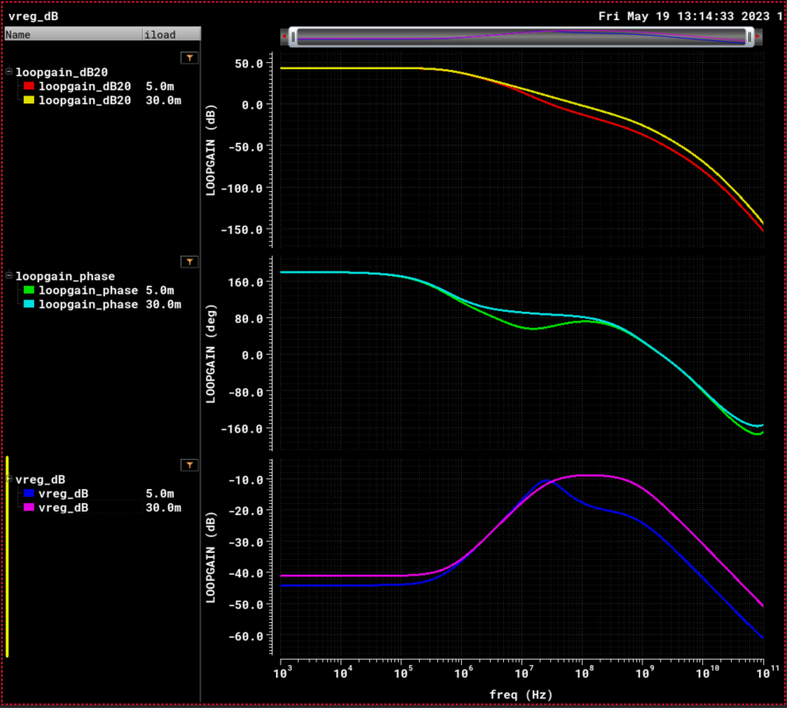
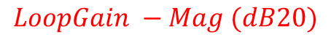
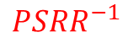
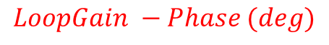
3) A. RC Compensation: Results
$$LoopGain −Mag (dB20)$$
$$LoopGain −Phase (deg)$$
$$PSRR^{−1}$$

Slide 23
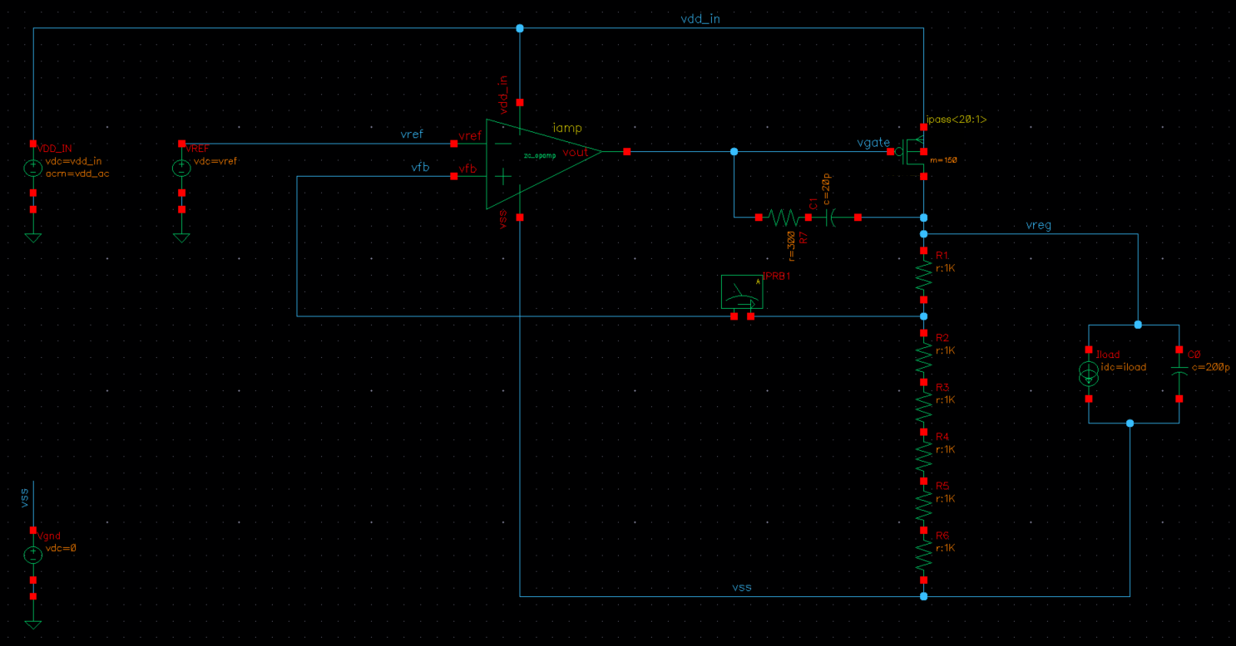
3) B. Miller Compensation: Testbench Schematics
Miller compensation
load

Slide 24
3) B. Miller Compensation: Testbench Schematics
Miller compensation
load

Slide 25
3) B. Miller Compensation: Testbench Maestro View

Slide 26
3) B. Miller Compensation: Testbench Maestro View
AC Analysis
STB Analysis

Slide 27
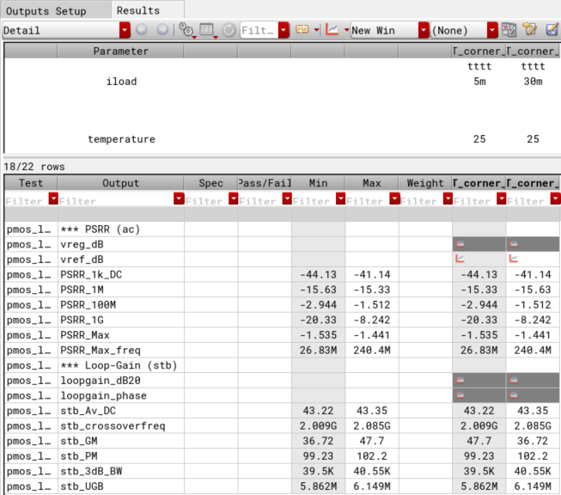
3) B. Miller Compensation: Results

Slide 28
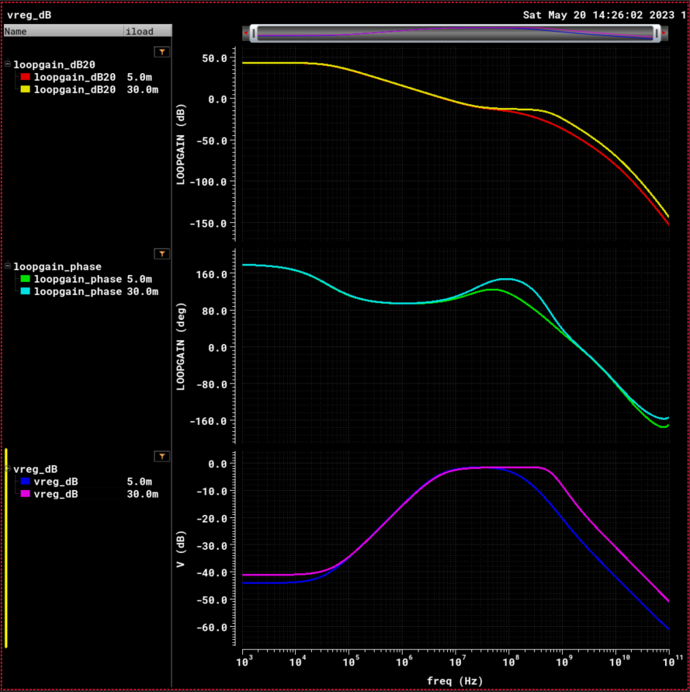
3) B. Miller Compensation: Results
$$LoopGain −Mag (dB20)$$
$$LoopGain −Phase (deg)$$
$$PSRR^{−1}$$

Slide 29
4) Noise Analysis
(Same Testbench as AC Testbench)

Slide 30
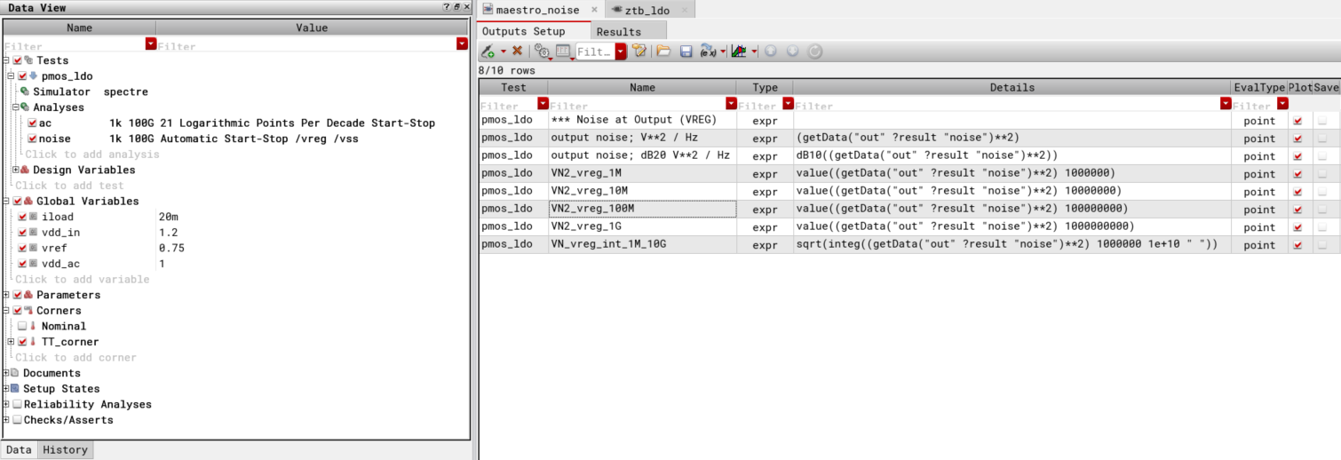
Testbench Maestro View

Slide 31
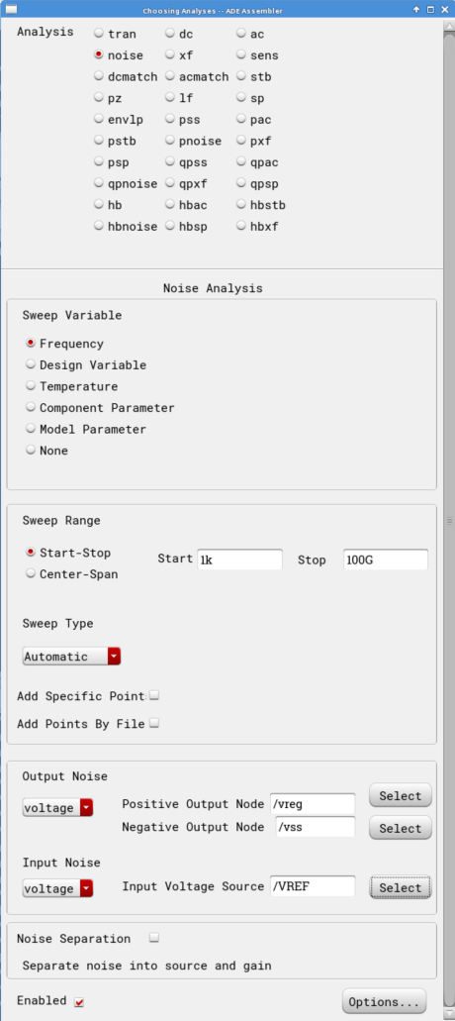
Testbench Maestro View
Noise Analysis

Slide 32
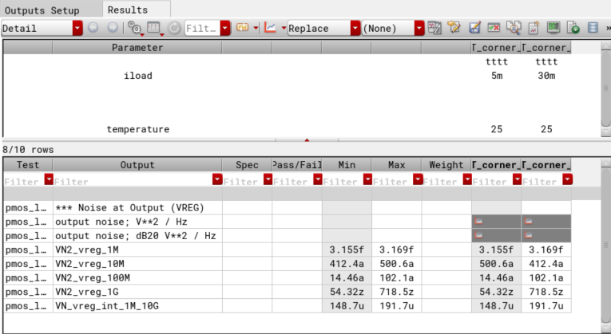
4) A. RC Compensation: Results

Slide 33
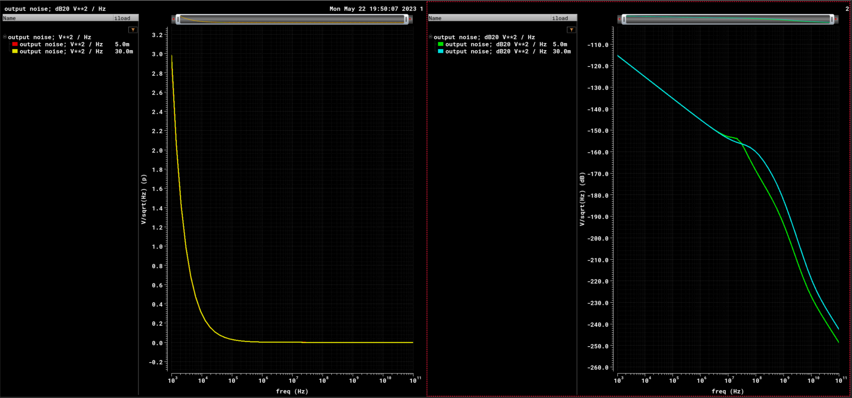


4) A. RC Compensation: Results
$$Noise \left(\frac{V^{2}}{Hz}\right)$$
$$Noise (dB)$$

Slide 34
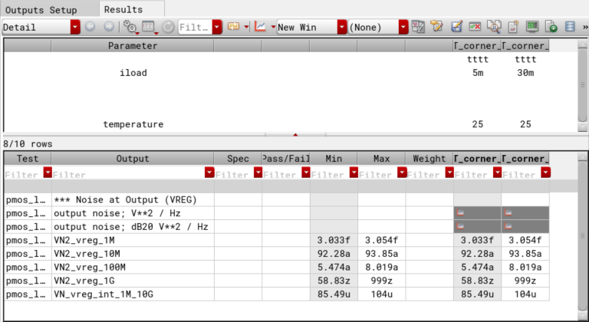
4) B. Miller Compensation: Results

Slide 35
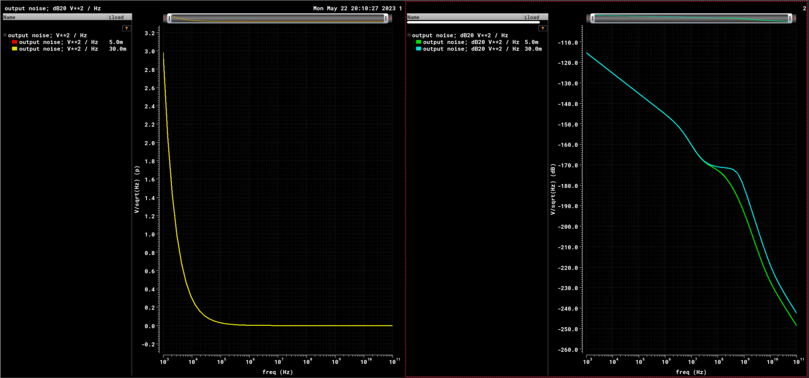
4) A. RC Compensation: Results
$$Noise \left(\frac{V^{2}}{Hz}\right)$$
$$Noise (dB)$$

Slide 36
5) Step-Load (Transient) VS AC/STB Sweep
Sweeping the compensation R changes the dominant pole & the zero frequencies.
This changes the PSRR, the stability, & the step-response of the system.

Slide 37
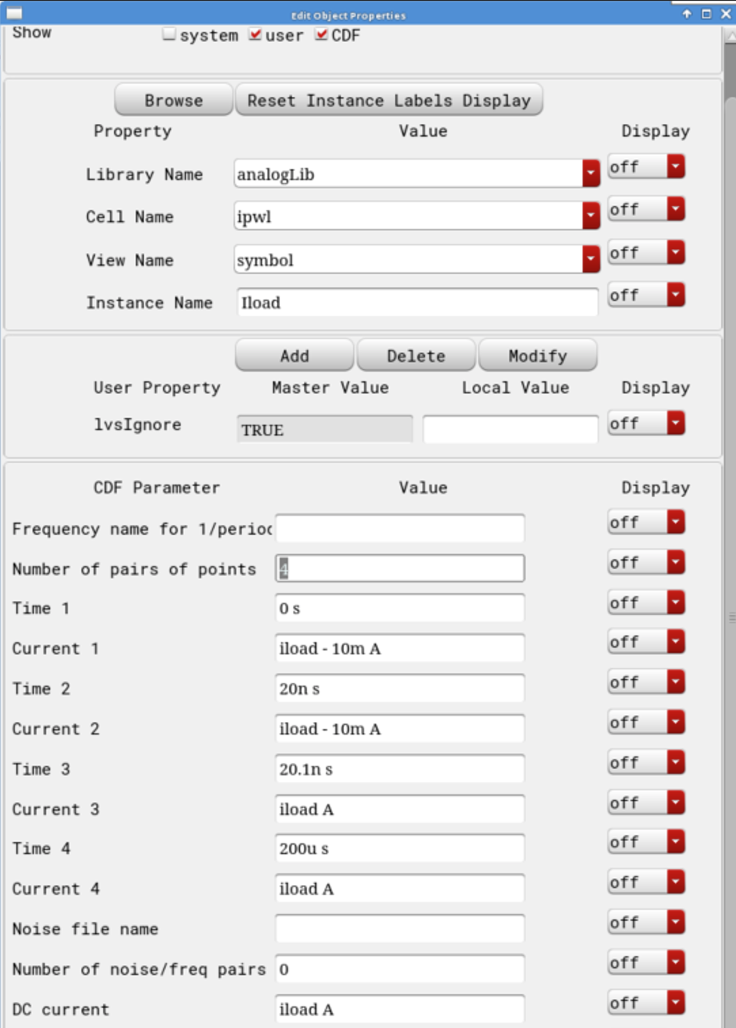
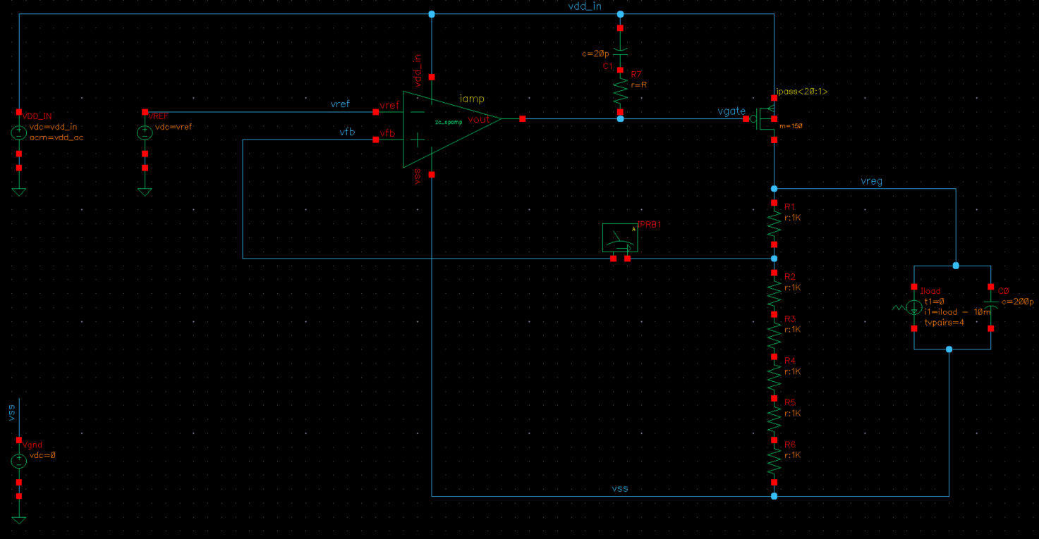
Testbench Schematics

Slide 38
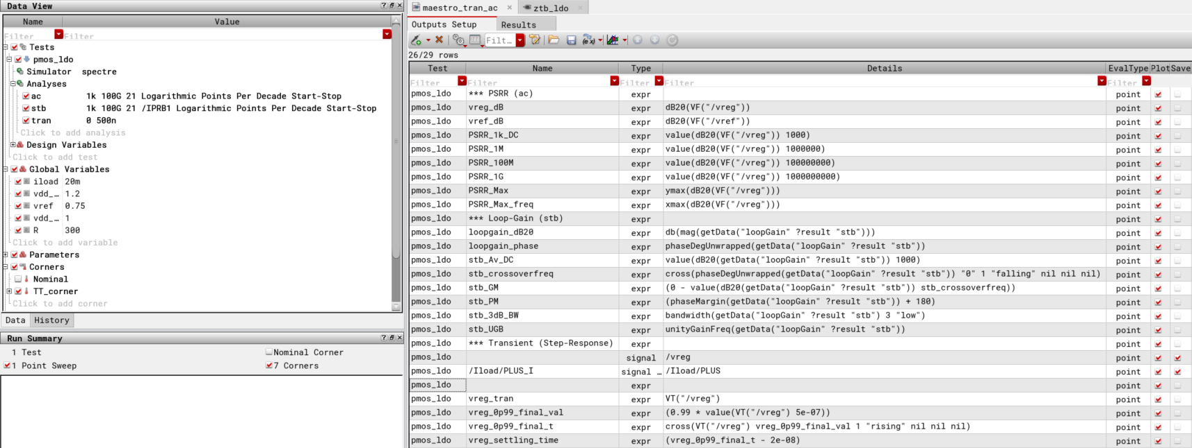
Testbench Maestro View

Slide 39
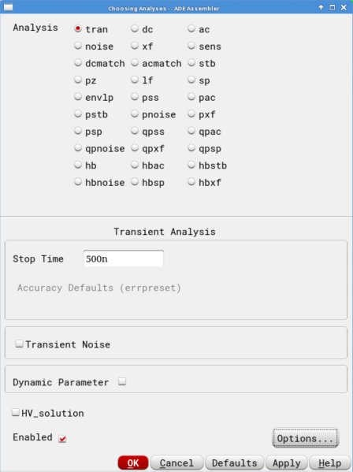
Testbench Maestro View
Transient Analysis

Slide 40
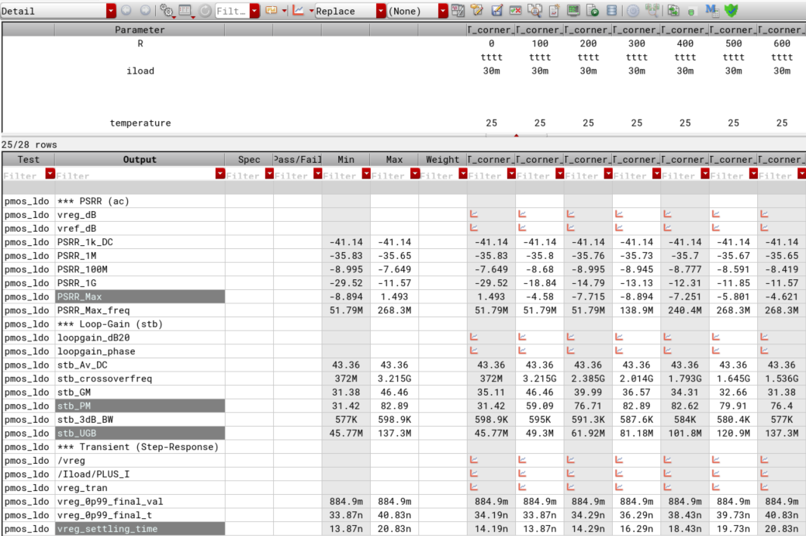
5) A. RC Compensation: Results
Sweeping R

Slide 41
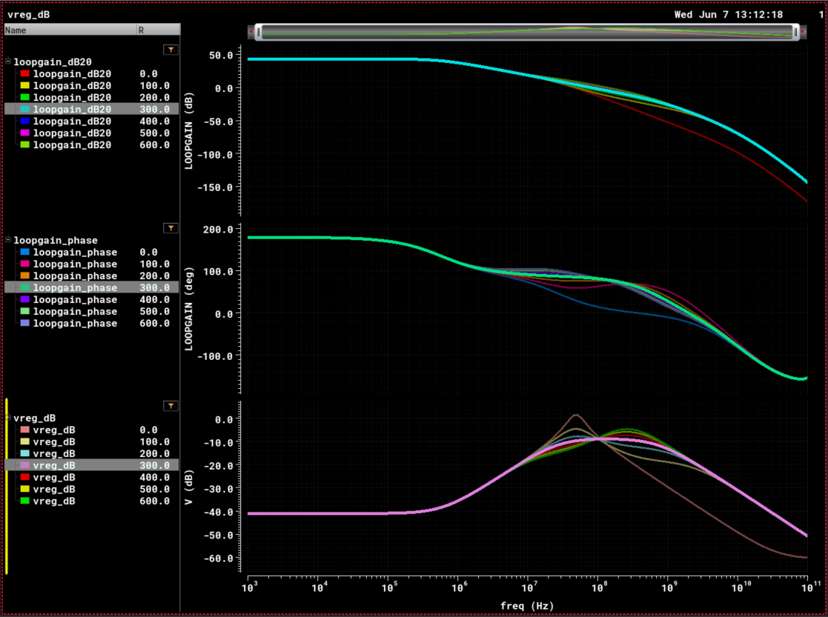
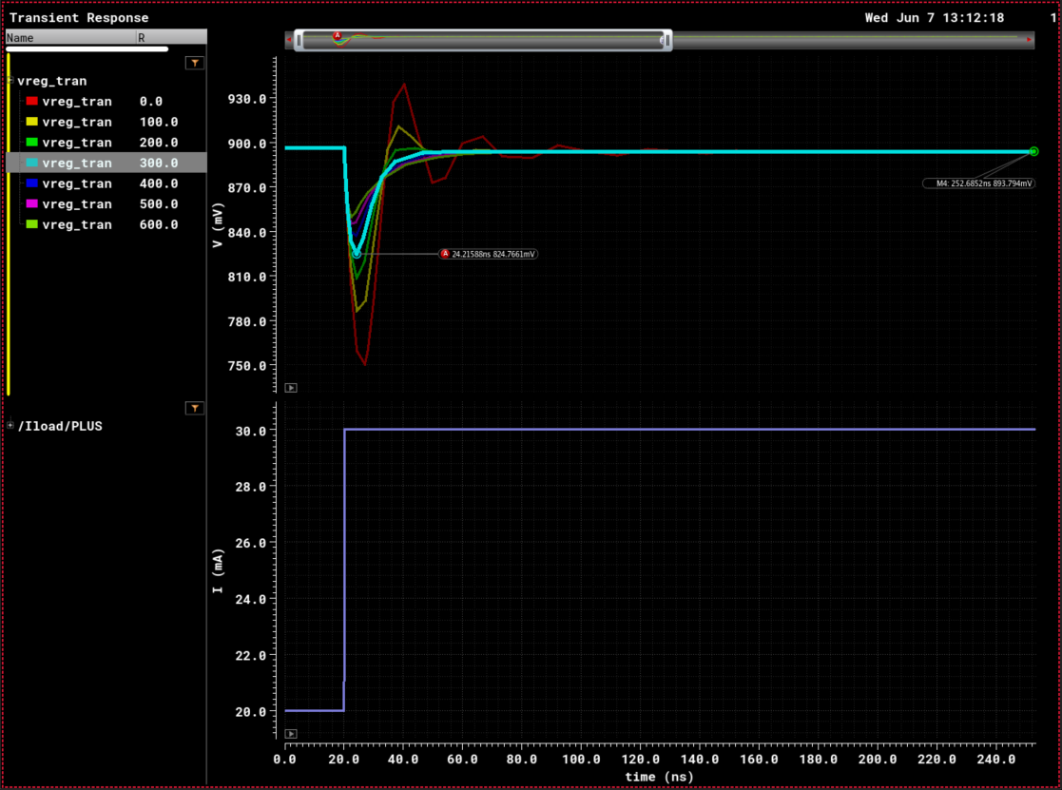
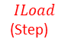


5) A. RC Compensation: Results (R= 300 Ohms)
$$LoopGain −Mag (dB20)$$
$$VREG$$
$$LoopGain −Phase (deg)$$
$$ILoad$$
(Step)
$$PSRR^{−1}$$

Slide 42
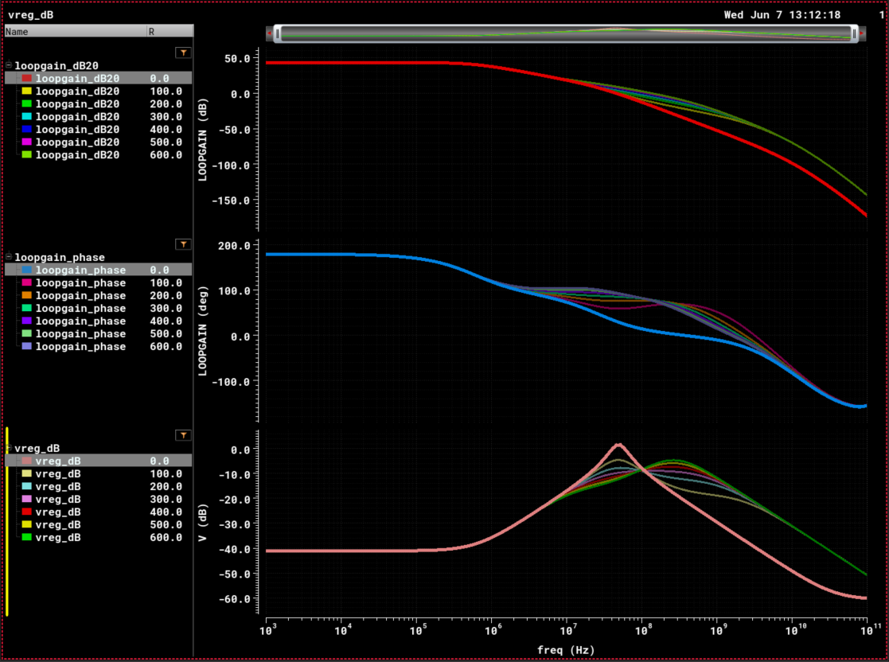
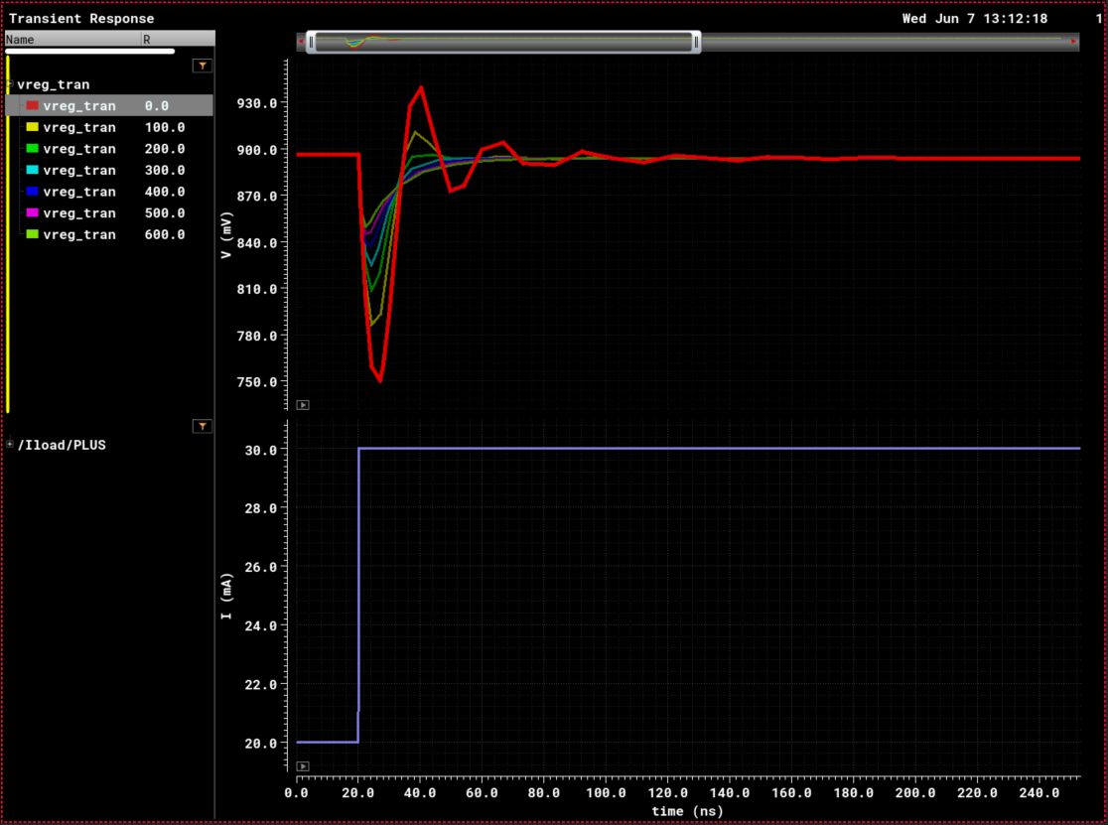
5) A. RC Compensation: Results (Sweeping R)

Slide 43
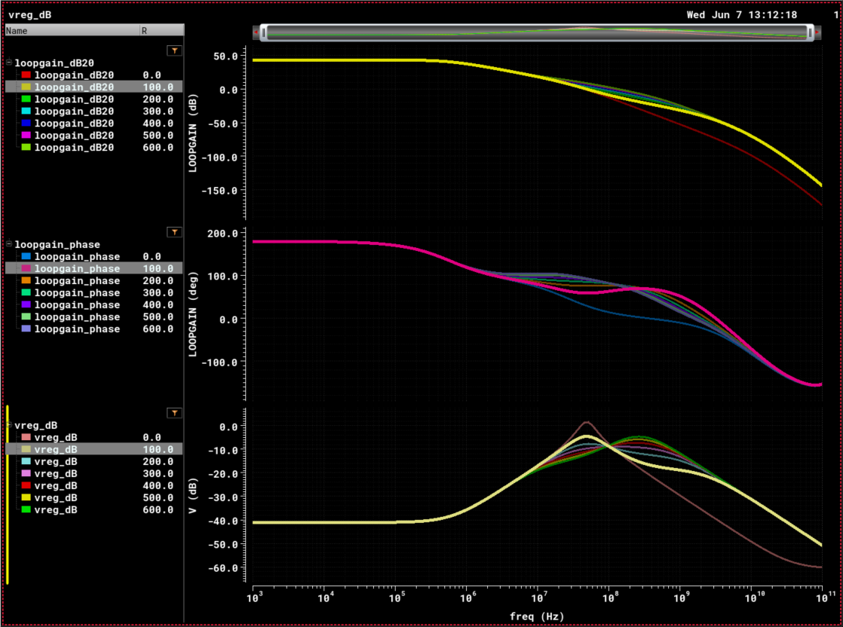
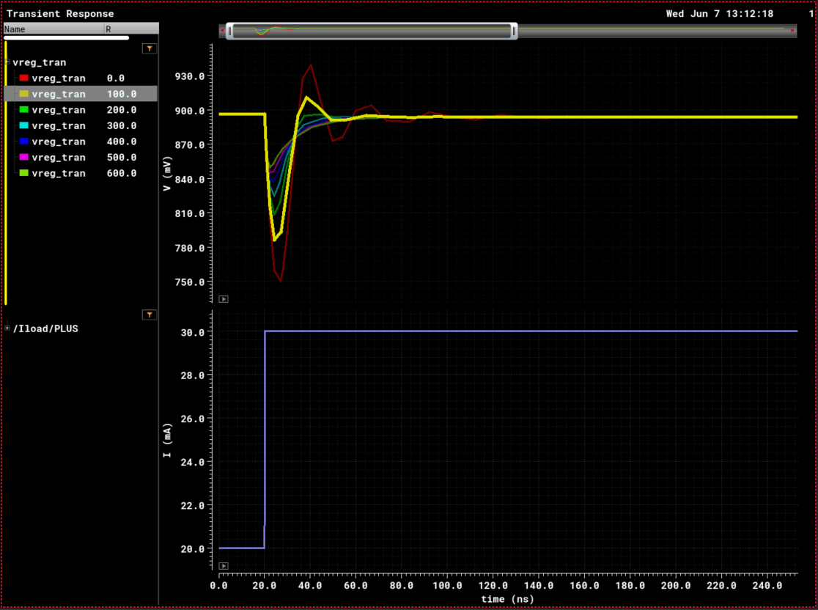
5) A. RC Compensation: Results (Sweeping R)

Slide 44
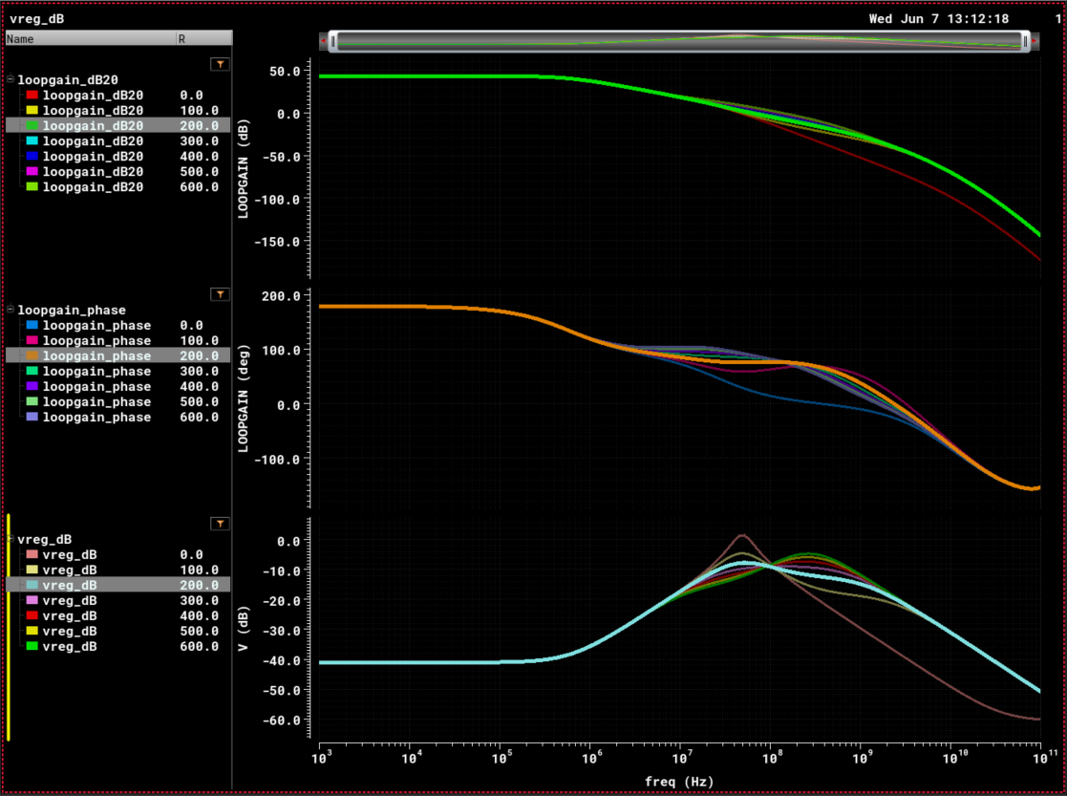
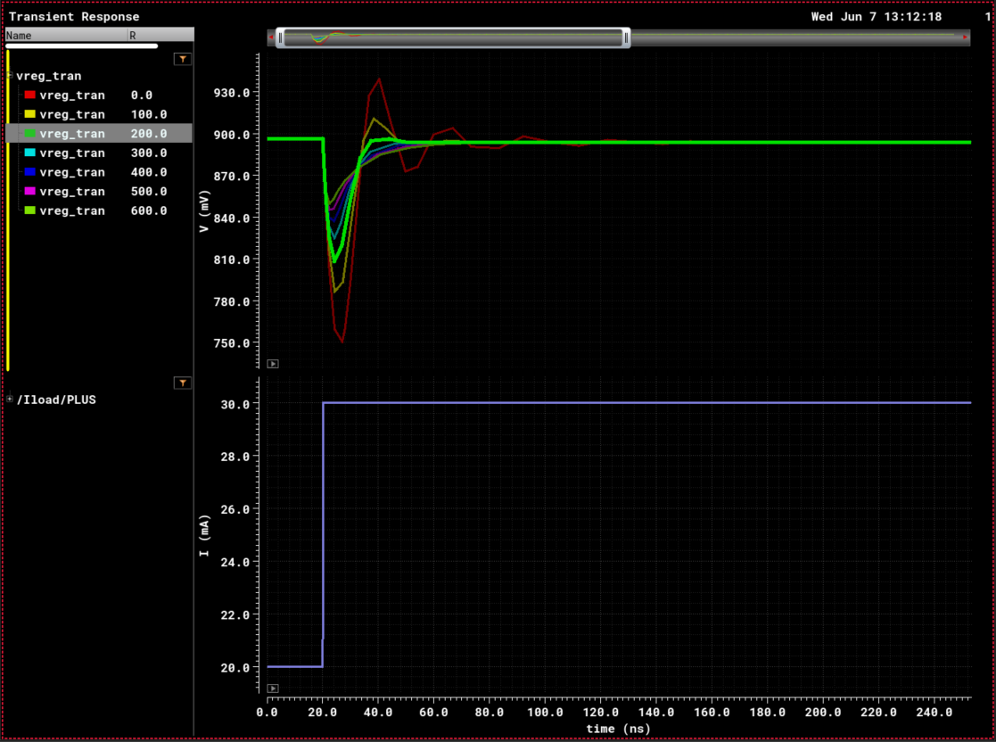
5) A. RC Compensation: Results (Sweeping R)

Slide 45
5) A. RC Compensation: Results (Sweeping R)

Slide 46
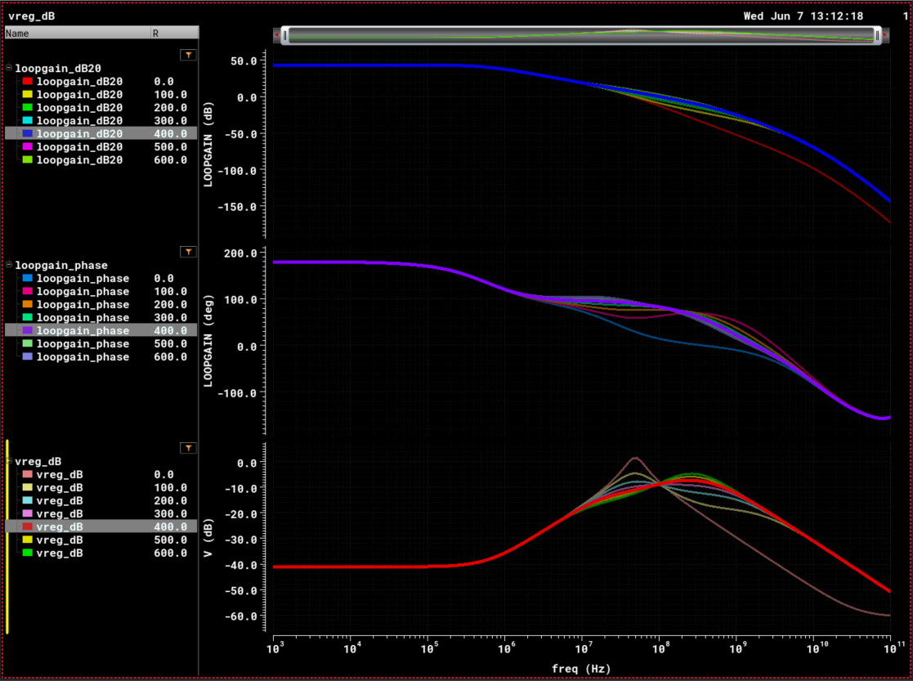
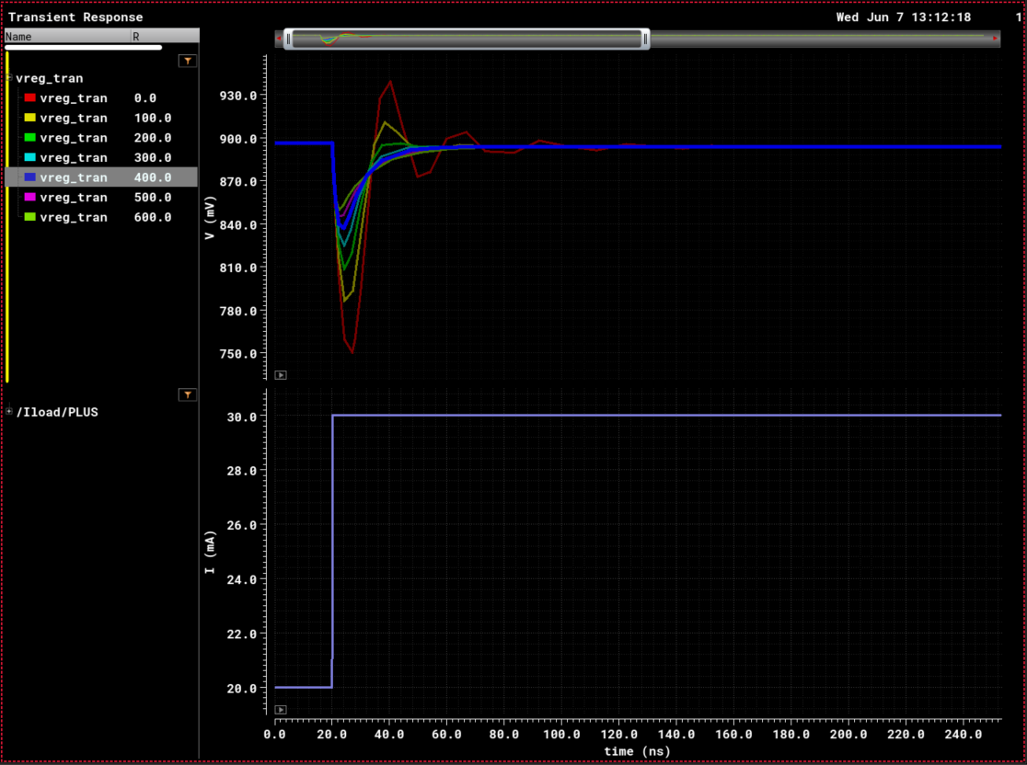
5) A. RC Compensation: Results (Sweeping R)

Slide 47
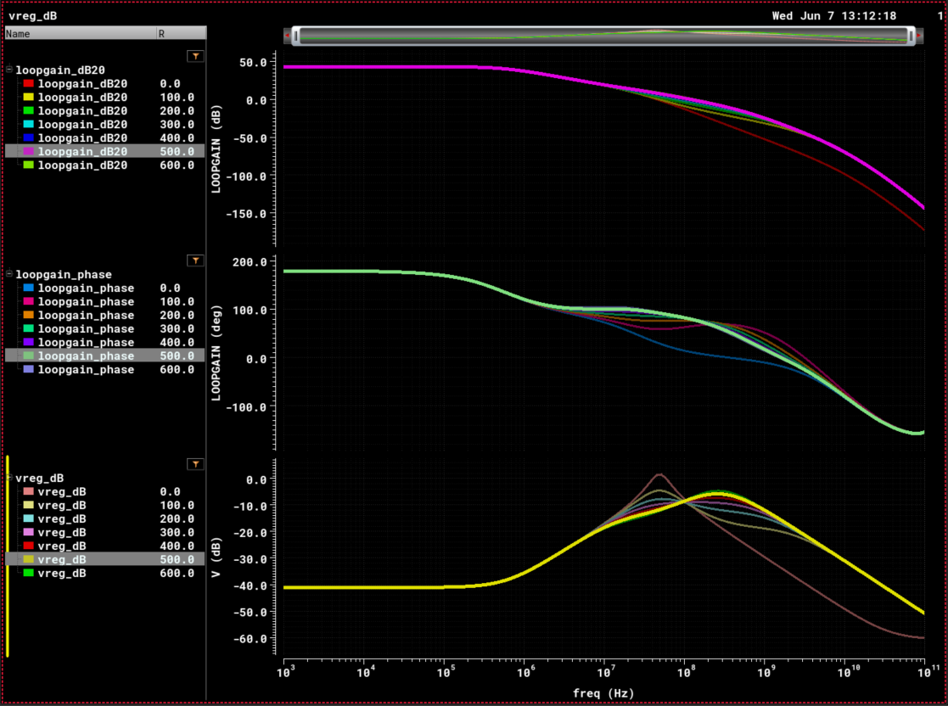

5) A. RC Compensation: Results (Sweeping R)

Slide 48


5) A. RC Compensation: Results (Sweeping R)

Slide 49

5) B. Miller Compensation: Results
Sweeping R

Slide 50


5) B. Miller Compensation: Results (R= 300 Ohms)
$$LoopGain −Mag (dB20)$$
$$VREG$$
$$LoopGain −Phase (deg)$$
$$ILoad$$
(Step)
$$PSRR^{−1}$$

Slide 51


5) B. Miller Compensation: Results (Sweeping R)

Slide 52


5) B. Miller Compensation: Results (Sweeping R)

Slide 53


5) B. Miller Compensation: Results (Sweeping R)

Slide 54
5) B. Miller Compensation: Results (Sweeping R)

Slide 55


5) B. Miller Compensation: Results (Sweeping R)

Slide 56


5) B. Miller Compensation: Results (Sweeping R)

Slide 57


5) B. Miller Compensation: Results (Sweeping R)

Slide 58

Results Summary
Parameters |  | Value
Supply Voltage |  | 1.2 V
Reference Voltage |  | 0.75 V
Regulated Voltage |  | 0.9 V
Load Current Range |  | 5 mA – 30 mA
Load Capacitor |  | 200 pF
Compensation | R | 300 Ohms
 | C | 20 pF
 |  | RC (Lead-Lag) Comp. | Miller Comp.
DC Gain (min) |  | 43.22 dB
Phase-Margin (min) |  | 60.34 deg | 99.23 deg
PSRR | @ DC | 41.14 dB | 41.14 dB
 | @ 1 MHz | 35.73 dB | 15.33 dB
 | @ 1 GHz | 13.13 dB | 8.24 dB
 | Worst case | 8.89 dB | 1.44 dB
Output Noise | Integrated from 1MHz to 10GHz | 191.7${uV}^{2}$ | 104 ${uV}^{2}$
Settling time (99%) |  | 16.29 ns | 20.05 ns
Offset | Mean (µ) | 770.2 uV
 | Std Dev (σ) | 1.513 mV

